Slide 1
Hata Model
Presented by: Imad HAMDACHE
JiaRui XIE
Antoni DALMASES TRILLA

Slide 2
Introduction
Okumura Model : Set of curves to calculate the path loss
Okumura Model : Simple and good in path loss prediction
Hata defined a series of empirical relationships describing the graphical method proposed by Okumura
The Hata Model provides median value of the basic propagation loss
Notes:
On the basis of extensive measurements carried out in Tokyo at frequencies in the range of 100 MHz to 1920 MHz, Okumura et al. published one of the most widely used models for path loss prediction in urban areas.
The main result of Okumura's work was a set of curves, giving the median attenuation, relative to free space, as a function of frequency, distance, heights and several path-specific correction factors. This model is considered to be among the simplest and best in terms of accuracy in path loss prediction. It has become a standard for system planning in modern mobile radio systems.
With the aim to make this method easy to apply, Hata defined a series of empirical relationships describing the graphical method proposed by Okumura. Such expressions, which are of empirical nature, are known as the Okumura-Hata model, also called as Hata model.
The main result provided by the model is the median value of the basic propagation loss, as a function of frequency, distance, base station height and mobile antenna height. Although it does not include any of the path-specific correction factors which are available in Okumura's model, the expressions proposed by Hata have significant practical value.*

Slide 3
Suitable environment
Frequency f (MHz) | 150 to 1500
Height of base station “hb” (m) | 30 to 200
Height of mobile station antenna “hm” (m) | 1 to 10
Distance between the base and mobile stations d (km) | 1 to 20
Notes:
(Though based on the Okumura model, the Hata model does not provide coverage to the whole range of frequencies covered by Okumura model. Hata model does not go beyond 1500 MHz while Okumura provides support for up to 1920 MHz. The model is suited for both point-to-point and broadcast communications, and covers mobile station antenna heights of 1–20 m, base station antenna heights of 30–200 m, and link distances from 1–10 km ( wikipedia, should be reformulated ))*/

Slide 4
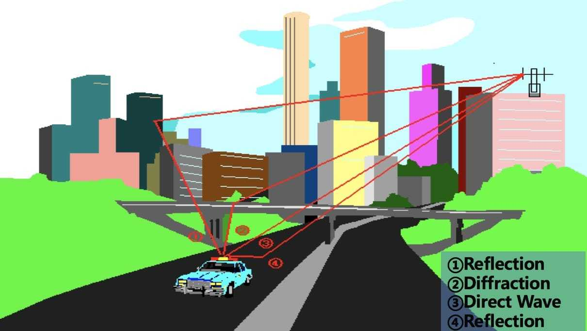
Why
The wireless propagation environment directly determines the choice of the propagation model. Major Factors:
Natural Terrain (mountains, hills, plains, waters)
Quantity, distribution, material properties of artificial buildings
Vegetation characteristics
Weather
Notes:
reflection Diffraction scattering Direction

Slide 5

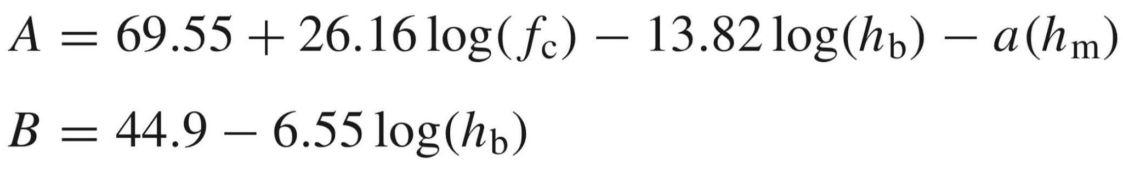
One Form of the Okumura-Hata Mode
Notes:
L_{U} = Path loss in urban areas. Unit: decibel (dB)
h_{B} = Height of base station antenna. Unit: meter (m)
h_{M} = Height of mobile station antenna. Unit: meter (m)
f = Frequency of transmission. Unit: Megahertz (MHz)
C_{H} = Antenna height correction factor
d = Distance between the base and mobile stations. Unit: kilometer (km).

Slide 6
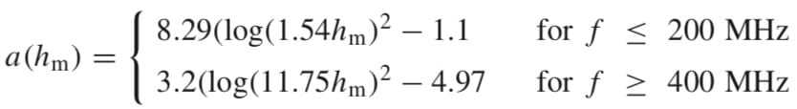
Different Situations - Urban
C = 0
Small or medium-sized city
Large cities

Slide 7

Different Situations
Suburban environments
Open environments

Slide 8
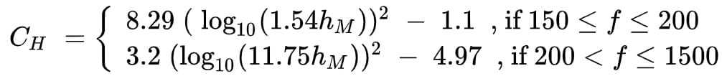
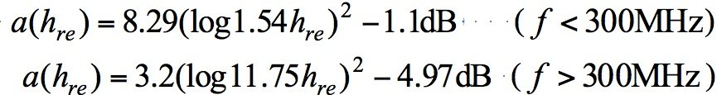
Something Wrong ?

Slide 9
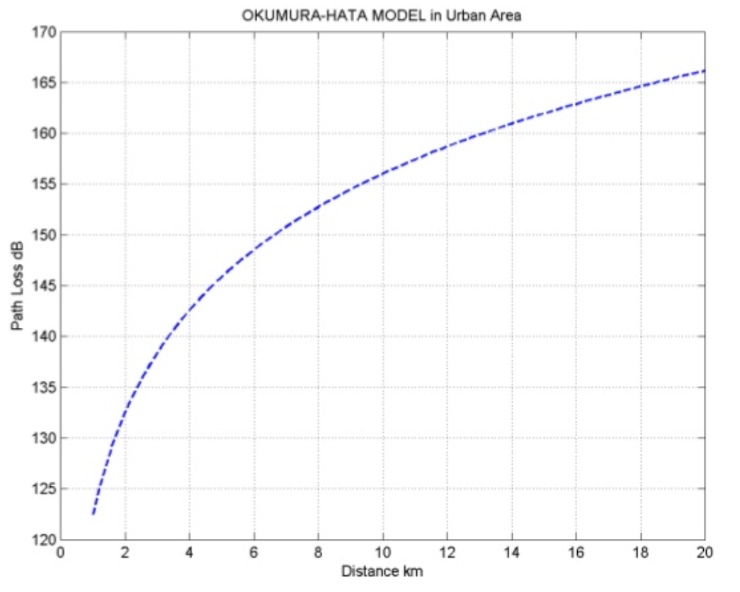
Path loss
Distance
f = 1000 MHz
hb = 50 m
hm = 3 m

Slide 10
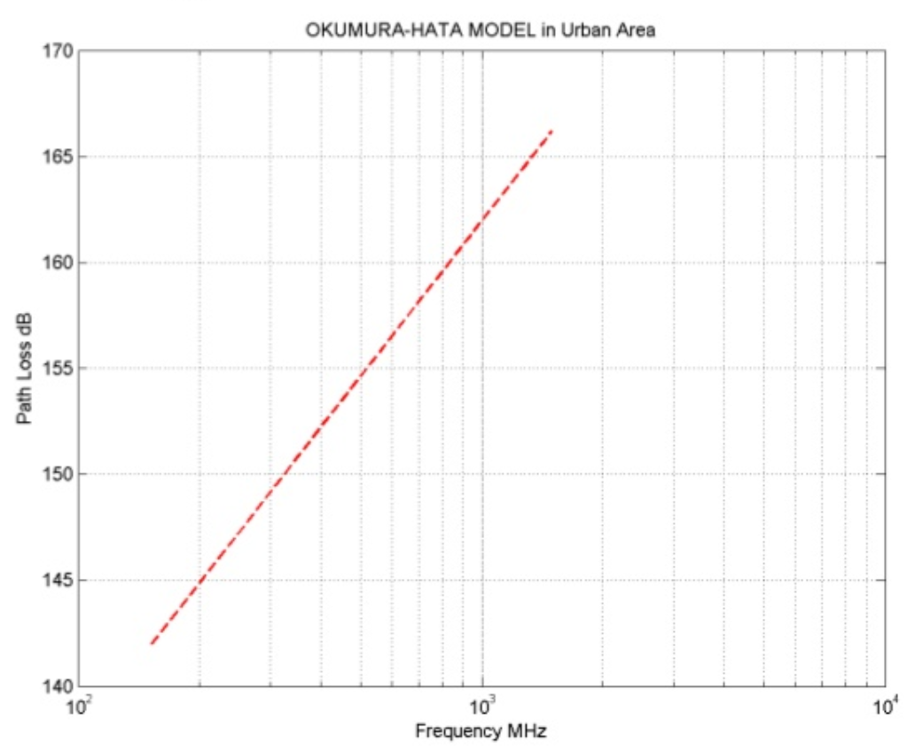
Path loss
Frequency
d = 15 Km
hb = 50 m
hm = 3 m
Notes:
Generally this model is quite good in urban and suburban environments, but not as good in rural areas, due to the fact that it does not take into account neither terrain undulation nor the effects derived from the degree of urbanization along the propagation path.

Slide 11
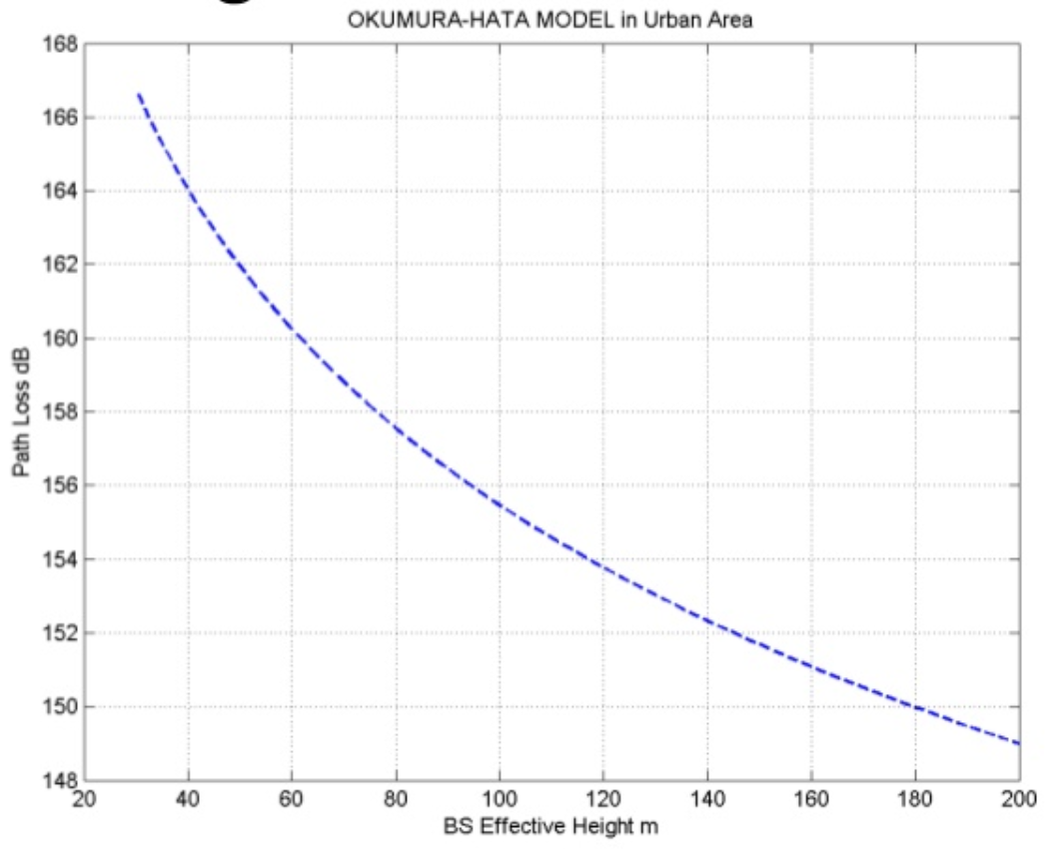
Path loss
Base antenna
d = 15 Km
f = 1000 MHz
hm = 3 m
Notes:
Generally this model is quite good in urban and suburban environments, but not as good in rural areas, due to the fact that it does not take into account neither terrain undulation nor the effects derived from the degree of urbanization along the propagation path.

Slide 12
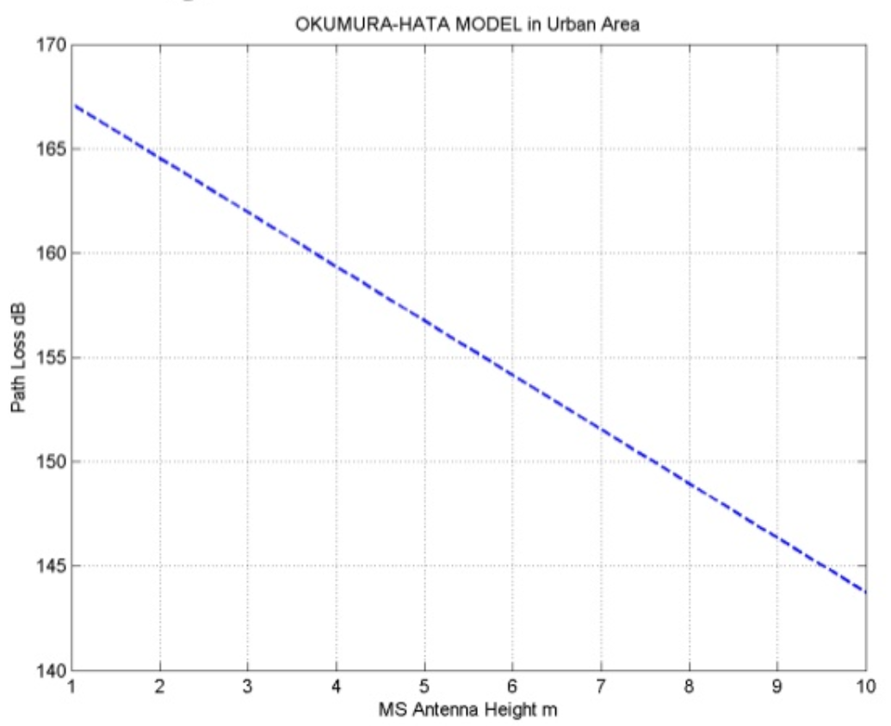
Path loss
Mobile antenna
d = 15 Km
f = 1000 MHz
hb = 50 m
Notes:
Generally this model is quite good in urban and suburban environments, but not as good in rural areas, due to the fact that it does not take into account neither terrain undulation nor the effects derived from the degree of urbanization along the propagation path.

Slide 13
Suitability for WLANs
 | Hata model | WLAN
Mobile station | 1 - 10 m | 10 cm
Base station | 30 - 200 m | 10 cm
Link distance | 1 - 20 km | 0 - 50 m
Recent researches have argued that Hata model can be used even in micro cell distances down to tens of meters from the transmitter under certain conditions.

Slide 14
Suitability for WLANs
Wireless Local Area Network (WLAN) channels are frequently accessed using IEEE 802.11 protocols.
2.4 GHz: 802.11b/g/n/ax
3.65 GHz: 802.11y
4.9–5.0 GHz: 802.11j
5 GHz: 802.11a/h/j/n/ac/ax
5.9 GHz: 802.11p
60 GHz: 802.11ad/ay
900 MHz: 802.11ah

Slide 15
References
Hata, M. "Empirical Formula for Propagation Loss in Land Mobile Radio Services." IEEE Transactions on Vehicular Technology 29, no. 3 (1980): 317-25. doi:10.1109/t-vt.1980.23859.
Nisirat, Mahdi A., Mahamod Ismail, Liyth Nissirat, and Salim Alkhawaldeh. "Is Hata Path Loss Model a Macro-cell Model Only? a Question of Debate." 2012 International Conference on Computer and Communication Engineering (ICCCE), 2012. doi:10.1109/iccce.2012.6271195.
Wiley Online Library "Appendix 7.A: The Okumura–Hata Model". https://www.wiley.com/legacy/wileychi/molisch/supp2/appendices/c07_Appendices.pdf

